Slide 1
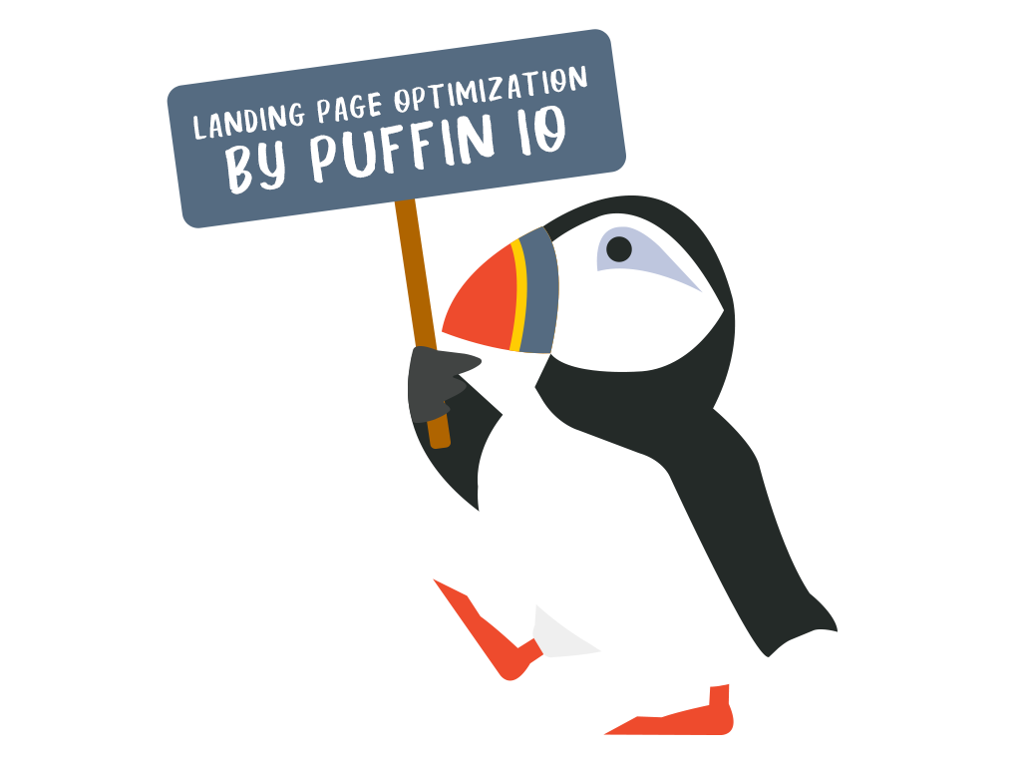
Landing Page Optimization
Created by: Puffin.io A/B Testing for Websites
The 30 Minute Guide Part 1

Slide 2
Landing Page Optimization - The 30 Minute Guide Part 1
Welcome to Puffin.io A/B Testing for Websites
This three-part series focuses on landing page optimization tips. We will cover tactics, strategies, and philosophies of A/B testing.

Slide 3
Landing Page Optimization - The 30 Minute Guide Part 1
This will be a helpful A/B testing guide for you and your friends at work.
A/B Testers novice/advanced looking to get a quick overview of essential and effective starting points for A/B testing wins.
CEOs and startup entrepreneurs seeking to gain key philosophical approach to creating a product end users love.
Engineers / Technical Co-Founders who are still writing code and want to quickly run A/B tests to increase essential business metrics.
Designers with an appetite to understand data, experimentation and metric driven design theory.
Growth PM who are in charge with optimization the entire end to end customer journey and want to refine top of the funnel conversion.

Slide 4
Landing Page Optimization - The 30 Minute Guide Part 1
Before we get started.
Have a clear understanding of your business goals. The business goals are the driving conditions for running any A/B test. And those requirements are what we optimize for.
When optimizing any landing page we want to ensure the task is aligned with the business goals. Optimizing a variable in a silo can increase the metric in the short term, at the expense of alienating the end user. Do not do this.

Slide 5
Landing Page Optimization - The 30 Minute Guide Part 1
The spirit of A/B testing is understanding what your visitors respond to when comparing two experiences. Recipe A is the current experience, Recipe B is the new experience. An example of a simple A/B test are button colors.
Recipe A (original) has a button color blue.
Recipe B (new) has a button color red
Upon review we might find button color red increased clicks by 10%.

Slide 6
Landing Page Optimization - The 30 Minute Guide Part 1
With A/B testing we learn what visitors are responsive to, becoming experts in our end users.
Testing allows us to increase essential business metrics while creating a frictionless customer journey your users love.

Slide 7
Landing Page Optimization - The 30 Minute Guide Part 1
Landing page optimization focuses on converting visitors arriving on your website (typically from paid ads) to registered users of your product or service--SaaS, gaming, banking, consumer, and more.
This is commonly referred to as top of the funnel optimization.
Ecommerce, funnel optimization, and other forms of A/B testing will be discussed in future series.

Slide 8
Landing Page Optimization - The 30 Minute Guide Part 1

Slide 9
Landing Page Optimization - The 30 Minute Guide Part 1
Our three specific topics.
Start with layout A/B testing first
Move to single element A/B testing next
How to think about A/B testing a redesign

Slide 10
Topic 1 - A/B testing layouts
Review the layout structure of your landing page. Don’t change the content - just the manner it is organized. Testing the structure of a landing page lets you understand how visitors consume your content. It also prepares you for future single element A/B testing (discussed later). Below are a few examples of restructured pages.
Recipe A
Recipe B
Recipe C

Slide 11
Topic 2 - Single element A/B testing
Single element A/B testing is elegant. Testing single elements is a low level of effort often yielding big increases in conversion. This will provide insights that guide your product/service strategy and philosophy. Try A/B testing variations of your hero image, headlines and button CTA to start.
Hero image element
Headline element
Button element

Slide 12
Topic 3- A/B testing a page redesign
Redesigns happen. Giant changes have lead to major increases in conversion. Understand the need for a redesign. Discover ways to evolve your landing page and mitigate the risks of significant design changes.
Recipe A
Recipe B

Slide 13
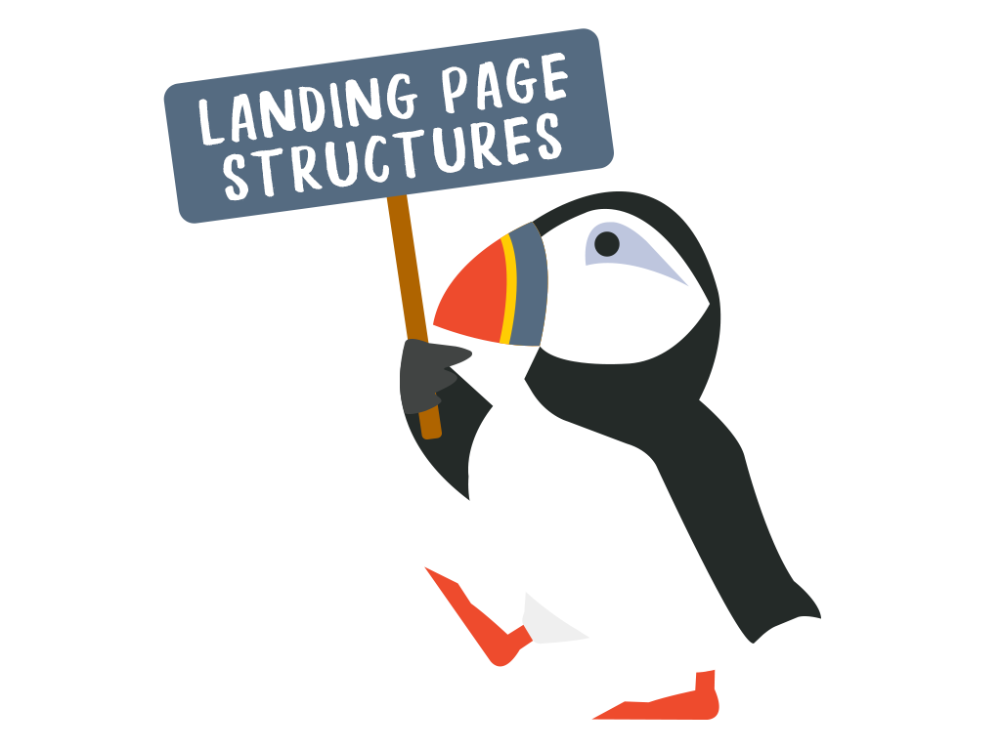
Example of A/B Testing Landing Page Structures

Slide 14
Example of A/B Testing Landing Page Structures
Landing page structures
Test the layout of your landing page first. This helps identify the layout visitors prefer.
After the layout is perfected, you are in a better position to A/B test single elements.
Let’s look at a layout A/B testing example.
Recipe A
Recipe B
Recipe C

Slide 15
Example of A/B Testing Landing Page Structures
Headline Here
This landing page, highlighted in orange, is using a non-traditional landing page structure.
In an attempt to appear modern, the design is muddied and hard to read.
Following a traditional layout provides end users a format to easily consume content and understand what is expected of them.
Unique value propositions here
Unique value propositions here
First Name
Last Name
Email
Confirm Email
Submit

Slide 16
Example of A/B Testing Landing Page Structures
Headline Here
Traditional structures resemble the example to the left, and include:
A justified hero image
Dedicated area for headline
Dedicated area for value propositions
Dedicated area for form fields
An explicit area for your call to action button
Nothing fancy or interesting. The content can be easily consumed and the end user understands what is expected of them.
But we need to test our assumptions!
Unique value propositions here
Unique value propositions here
First Name
Last Name
Email
Confirm Email
Submit

Slide 17
Example of A/B Testing Landing Page Structures
Headline Here
When we launch this A/B test, we call it "Modern vs Traditional layouts"
We did not change the content of this landing page. We only changed the format in which the original content was presented.
It’s an attempt to better organize our content for future A/B tests.
By leveraging the traditional landing page format, we were able to increase conversion (leads/MQL) by 33%.
Unique value propositions here
Unique value propositions here
First Name
Last Name
Email
Confirm Email
New layout increased conversions by 33%
Submit

Slide 18
Example of Single Element A/B Testing

Slide 19
Example of Single Element A/B Testing
Single element A/B testing surfaces deep insights
After testing the layout of your landing page, start focusing on specific elements to A/B test
A/B testing a single element powerful because utility is high and level of effort is low. The insights gathered can alter your business strategy.

Slide 20
Example of Single Element A/B Testing
Headline Here
We have a traditional structured landing page and plenty of specific elements to A/B Test.
One element I often see missing from traditional landing pages is a real life testimonial.
Testimonials come in many forms. It’s important to find one that can be presented to the end user and reduce the friction and anxiety of completing the form.
A form requires effort to complete. The effort creates anxiety. Testimonials can provide a specific and additional incentive to help reduce the anxiety and shepherd the end user to completing the registration.
Unique value propositions here
Unique value propositions here
First Name
Last Name
Email
Confirm Email
Submit

Slide 21
Example of Single Element A/B Testing
Headline Here
This testimonial provided a 15% increase in conversion (leads/MQL).
The testimonial focused on “time saving”. End users are inspired by this specific value, and it’s driving the appropriate behavior.
You and your team have evidence that “time saving” elements are an attributing factor to conversion increases.
This helps provide an essential learning to leadership and cross-functional teams.
This is an example of how single element A/B testing can drive deeper insights to further propel your business forward.
Testimonial increased conversion by 15%
Unique value propositions here
Unique value propositions here
First Name
Last Name
Email
Confirm Email
Submit
“This saved us time”
Steve - Dallas, Texas

Slide 22
Example of Single Element A/B Testing
Let’s zoom out for a moment

Slide 23
Example of Single Element A/B Testing
1
Tactics drive explicit insights to increasing conversion. Example: visitors respond to “saving time.” How can this be further exploited?
As a theme, if "saving time" increases conversion, we can leverage this as a new philosophical base across the organization. Can we start to shift the end to end customer journey and further monetize on this finding?
2
Tactics
Team/Technologies
Strategies
Philosophical Themes

Slide 24
Example of Single Element A/B Testing
4
How do team structures and technologies play a part in monetizing this overarching theme of “time saving”? Does marketing shift to support this content? Does product shift to support features of this nature?
Tactics
How does “time saving” get incorporated into the end user experience - ads, email, content creation, dedicated testimonial pages, and further driving this theme into the experience?
3
Team/Technologies
Strategies
Philosophical Themes

Slide 25
Examples of A/B Testing Radical Redesigns

Slide 26
Examples of A/B Testing Radical Redesigns
Expectations for radical redesigns
We now understand what type of layout structure is working. We started single element A/B testing, and now a redesign is mandated. What do we do?

Slide 27
Examples of A/B Testing Radical Redesigns
Redesigning a landing page
Everyone encounters a landing page redesign. And no matter where you sit in an organization we should work together, reduce risk and increase the conversion rate.
A few reasons on why redesigns happen
Brand change
Product change
Company maturity
Boiling the ocean tactics - beware

Slide 28
Examples of A/B Testing Radical Redesigns
Leverage A/B testing to mitigate risk of a redesign
Evolve into the new design with A/B testing. Slowly make small, tested adjustments to the landing page that incorporates the new design elements. This helps reduce unexpected negative results.

Slide 29
Examples of A/B Testing Radical Redesigns
Use A/B testing and evolve into the redesign of your landing page
Recipe A (Original Design)

Slide 30
Examples of A/B Testing Radical Redesigns
Use A/B testing and evolve into the redesign of your landing page
Recipe A (Original Design)
Recipe B (Evolution phase)

Slide 31
Examples of A/B Testing Radical Redesigns
Use A/B testing and evolve into the redesign of your landing page
Recipe A (Original Design)
Recipe B (Evolution phase)
Recipe C (New Design)

Slide 32
Examples of A/B Testing Radical Redesigns
The evolution of redesign with A/B testing
A landing page redesign can present challenges. A/B testing can help reduce the risk of big change.
A/B testing is innately safe. Recipe A always represents the default experience and provides a quick way to rollback if the data does not support your hypothesis or redesign.
Recipe C (New Design)

Slide 33
Examples of A/B Testing Radical Redesigns
Redesign increased conversions by 65%
Redesigning with A/B testing and user feedback
Before launching a redesign, get real customer feedback.
For example, we leveraged surveys before we launched a redesign. Using customer feedback, we were able to refine the overall design before A/B testing.
This process was repeated until we found a design iteration we were confident in testing. The results of our A/B test were astounding—a 65% increase in conversion rate.
Recipe A (Original Design)
Recipe C (New Design)

Slide 34
Conclusion and summary

Slide 35
Landing Page Optimization The 30 Minute Guide Part 1
Here are a few tips to get better performing landing pages.
A/B testing different layout structures will help optimize the general design of your landing page. and sets a solid foundation for future single element A/B tests.
Single element A/B testing provides deeper insight to what your visitors are responsive to. It is a low level of effort tactic that often yields tremendous lift in conversion and influences your philosophical approach.
Landing page redesigns always have their business requirements. Leverage A/B testing reduces risks and helps your product evolve into an experience customers love. Large redesigns are not required to achieve big increases in conversion.

Slide 36
Landing Page Optimization
Q&A
Created by: Puffin.io A/B Testing for Websites
The 30 Minute Guide Part 1

